Slide 1
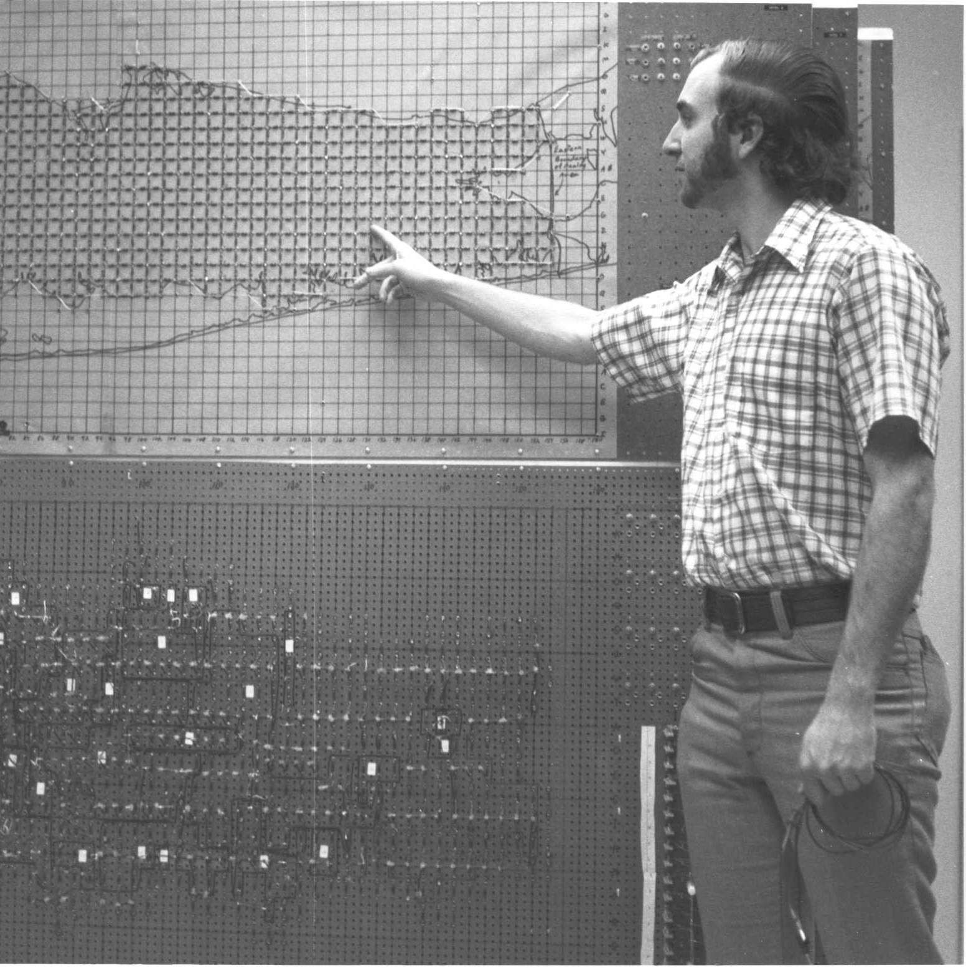
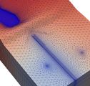
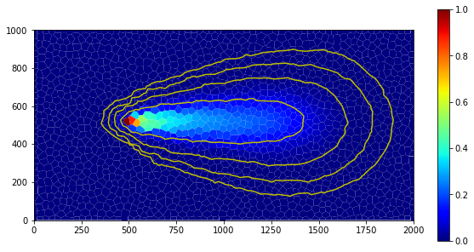



Model Partitioning and Load Balance
Parallel MODFLOW Training Class, July 13-14, 2023, Lakewood, CO
Notes:
Why parallel?
Different forms of parallelism, which one for MODFLOW 6?
Theoretical expectations on performance?

Slide 2
Load Imbalance
Keep processors busy, or:
“An army marches only as fast as its slowest soldier”
Split up domain based on expected work
But, might be time dependent, e.g. from stress period data
Remedy: dynamic load balancing
Multiple smaller models per process, redistribute when out of balance
Invasive
And how about two coupled processes…

Slide 3
Load Imbalance
Keep processors busy, or:
“An army marches only as fast as its slowest soldier”
Split up domain based on expected work
But, might be time dependent, e.g. from stress period data
Remedy: dynamic load balancing
Multiple smaller models per process, redistribute when out of balance
Invasive
And how about two coupled processes…

Slide 4
Load Imbalance
Keep processors busy, or:
“An army marches only as fast as its slowest soldier”
Split up domain based on expected work
But, might be time dependent, e.g. from stress period data
Remedy: dynamic load balancing
Multiple smaller models per process, redistribute when out of balance
Invasive
And how about two coupled processes…
#1
#2
#3
#4
busy
synchronize
idle
synchronize
synchronize

Slide 5
Load Imbalance
Keep processors busy, or:
“An army marches only as fast as its slowest soldier”
Split up domain based on expected work
But, might be time dependent, e.g. from stress period data
Remedy: dynamic load balancing
Multiple smaller models per process, redistribute when out of balance
Invasive
And how about two coupled processes…
#1
#2
#3
#4
busy
synchronize
idle
synchronize
synchronize

Slide 6
Load Imbalance
Keep processors busy, or:
“An army marches only as fast as its slowest soldier”
Split up domain based on expected work
But, might be time dependent, e.g. from stress period data
Remedy: dynamic load balancing
Multiple smaller models per process, redistribute when out of balance
Invasive
And how about two coupled processes…
#1
#2
#3
#4
busy
synchronize
idle
synchronize
synchronize

Slide 7
Load Imbalance
Keep processors busy, or:
“An army marches only as fast as its slowest soldier”
Split up domain based on expected work
But, might be time dependent, e.g. from stress period data
Remedy: dynamic load balancing
Multiple smaller models per process, redistribute when out of balance
Invasive
And how about two coupled processes…
#1
#2
#3
#4
busy
synchronize
idle
synchronize
synchronize

Slide 8
Load Imbalance
Keep processors busy, or:
“An army marches only as fast as its slowest soldier”
Split up domain based on expected work
But, might be time dependent, e.g. from stress period data
Remedy: dynamic load balancing
Multiple smaller models per process, redistribute when out of balance
Invasive
And how about two coupled processes…
#1
#2
#3
#4
busy
idle
synchronize
GWF
synchronize
GWT
synchronize

Slide 9
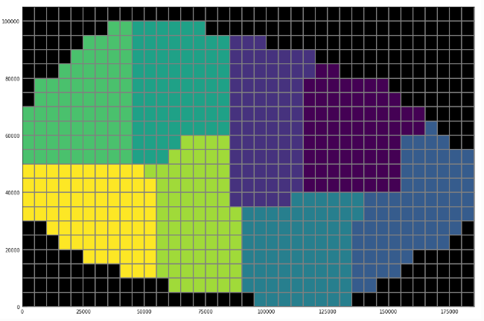
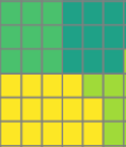
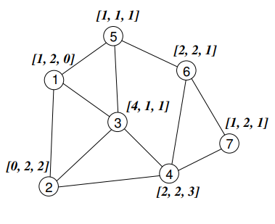
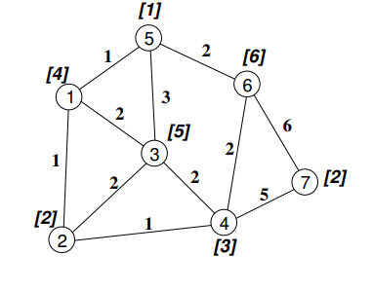
Model Partitioner
Split in subdomains based on estimate of work and communication
Account for active cells, also vertically
Different formulations
Special, compute intensive features
Minimize the amount of communication between domains
Minimize the number of neighboring domains
Use graph partitioning algorithm
Weight factor is typically associated with node (cell) and/or edge (connection)
Size to represent communication volume
Multi-physics balancing with list of weights

Slide 10
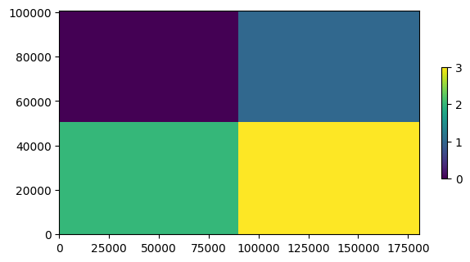
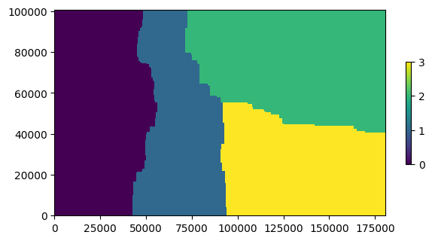
FloPy Model Splitter
Rectangular split:
FloPy contains a facility for partitioning a MODFLOW 6 model:
flopy/mf6/utils/model_splitter.py
Configure with the simulation object:
mfsplit = Mf6Splitter(base_sim)
Methods to generate a split_array by
division in rectangular blocks
optimized splitting with Metis
Split the model:
new_sim = mfsplit.split_model(split_array)
… More on this in today’s hands-on
Metis split:

Slide 11

Questions?

